Slide 1
OLA Data Analysis Report
Transforming Raw Data into Operational Intelligence
Bachelor of Technology (CSE) Final Project
Submitted By: Shivansh Sharma
Reg No. : 12200681

Slide 2
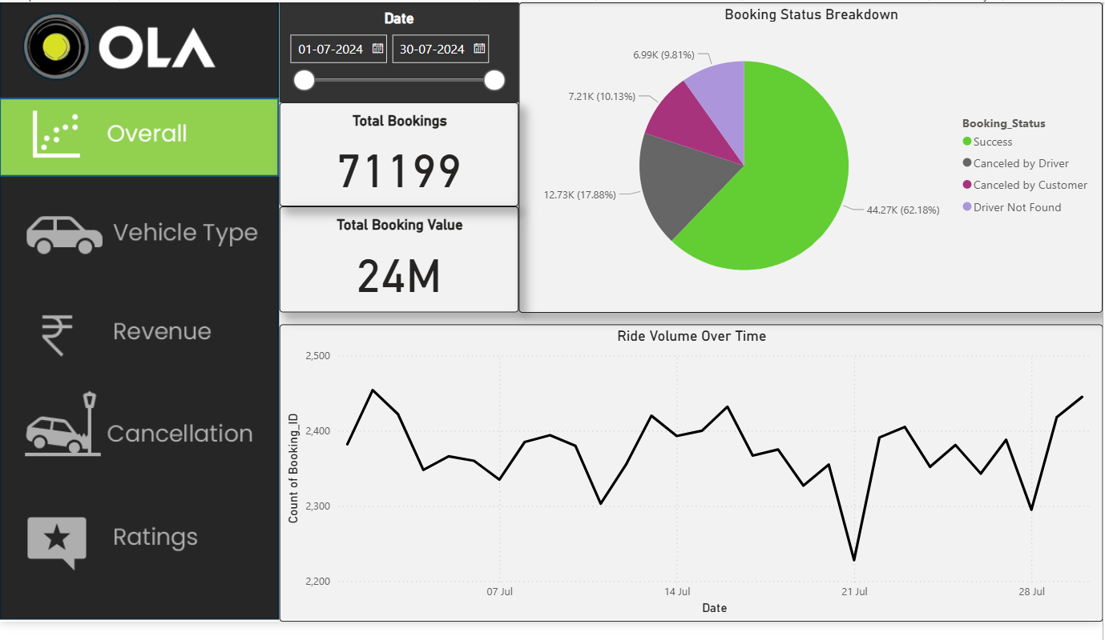

Project Overview
Ride-hailing services generate massive volumes of transactional data daily. This project bridges the gap between raw database records and strategic decision-making.
Goal 1: Visualization Strategy
Create a holistic Power BI dashboard to replace static reporting with interactive monitoring.
Goal 2: Operational Efficiency
Diagnose the specific reasons behind the 37.8% booking failure rate.

Slide 3






The Need for Business Intelligence
High Churn Risk
Revenue Leakage
Data Paralysis
A 37.8% failure rate isn't just lost revenue; it's lost trust. Without knowing why rides fail, we cannot implement targeted retention strategies.
Certain routes and payment methods may correlate with higher fraud or cancellation rates. Identifying these "leakage points" is crucial.
Managing 50 locations and thousands of drivers via spreadsheets leads to "data paralysis." Managers need instant visual cues.

Slide 4

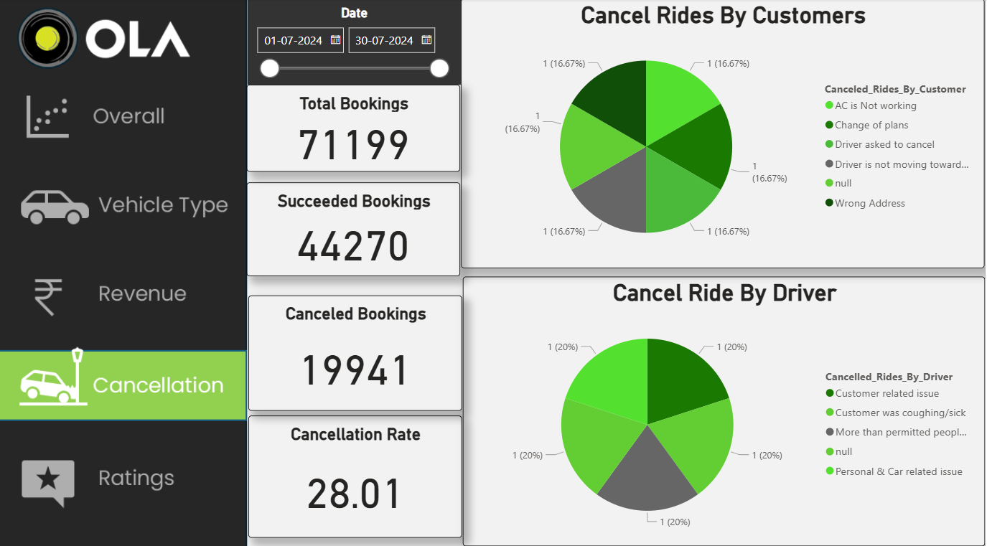
Methodology & Architecture
Process Model (Waterfall): We utilized a structured Waterfall approach. The requirements were fixed (the dataset), followed by a rigorous Data Cleaning phase in Python, Modeling in SQL, and finally Visualization in Power BI.
Data Modeling : To optimize query performance, we normalized the data into a Star Schema. The central Fact Table tracks individual bookings, linked to Dimension Tables for Date, Customer, and Vehicle types.
Tools Used: Power BI (DAX/Viz), MySQL (Storage), Python (Pandas).

Slide 5



Executive Summary KPIs
₹24.2M
62.2%
71,201
Total Revenue
Success Rate
Total Volume
Monthly Run Rate (July 2024)
Benchmark: >75% Desired
High Demand across 50 Areas
The data reveals a "High Volume, High Friction" environment. While demand is robust (71k bookings), the operational friction (38% failure) is acting as a severe throttle on potential revenue growth.

Slide 6
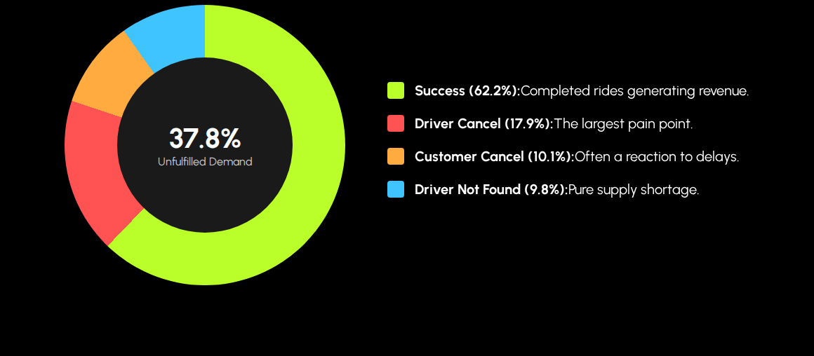
Booking Status Decomposition
Analysis: Driver-initiated cancellations (17.9%) are nearly double that of customers. This indicates the primary issue lies with fleet management and driver incentives rather than customer intent.

Slide 7
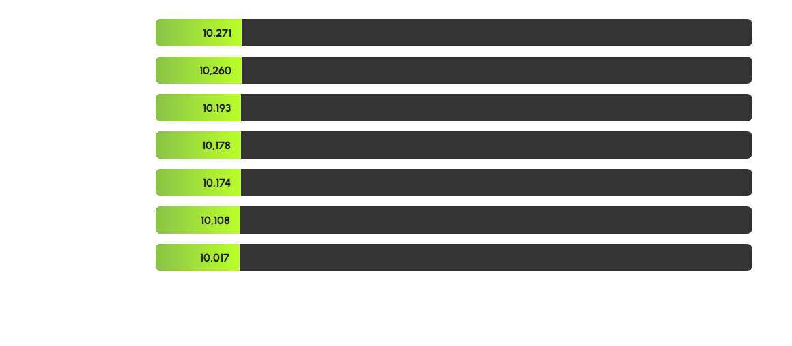
Vehicle Fleet Distribution
Insight: The dataset shows a near-perfect uniform distribution (~14% per category). This suggests the platform is artificially capping or allocating ride requests to balance fleet utilization, rather than reflecting organic market demand (where cheaper options like Auto usually dominate).

Slide 8
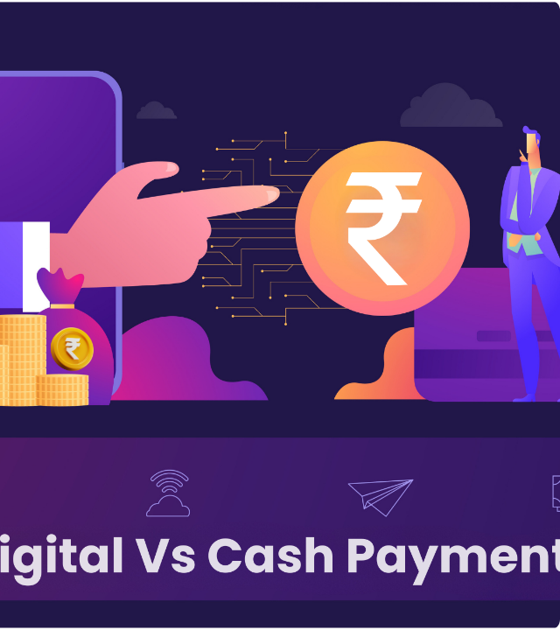
Payment Habits & Liquidity
The Cash Dominance (54.6%): Over half of all revenue (₹13.2M) enters the system as physical cash. This creates a "Collection Lag," as OLA must recoup its commission from the drivers' digital wallets later, increasing credit risk.
UPI Adoption (40.6%): While UPI is strong, it hasn't yet overtaken cash. Pushing this number higher is essential for real-time revenue realization.
Credit Card Friction (< 5%): The negligible use of cards highlights the Indian market's aversion to OTP friction for micro-transactions. Future UI updates should deprioritize card options.

Slide 9



Root Cause Analysis: Why Rides Fail?
Driver Drivers
Customer Drivers
•
Personal & Car Issues (35%): This is alarmingly high, suggesting an aging fleet requiring maintenance, or drivers logging off abruptly due to fatigue.
•
Driver Not Moving (30%): The #1 customer complaint. Drivers accept rides to see the destination, then "stall" to force the customer to cancel to avoid penalties.
•
Customer Related (29.5%): Drivers often cancel if they dislike the destination or payment mode (e.g., refusing digital payments).
•
Driver Asked to Cancel (25.7%): A direct violation of policy, often done to negotiate off-platform cash fares.
•
Sickness (20%): Highlights the need for better driver health benefits/insurance.

Slide 10

From Data to Decisions
"This analysis uncovered ₹14.7 Million in potential revenue currently lost to cancellations and inefficiencies. By shifting from reactive reporting to proactive BI monitoring, OLA can reclaim this lost value and optimize the rider experience."

Slide 11
Questions & Discussion
Thank you for your attention.

